Slide 1
Predicting Dengue Using Climate Data
www.drivendata.org/competitions/44/dengai-predicting-disease-spread/

Slide 2
The global burden of dengue has grown dramatically in recent decades.
An estimated 400 million dengue virus infections per year
~ 95 million develop clinically, having a level of severity
Because dengue infections are increasing and covering more parts of the world, predicting case numbers has become in important goal for protecting the health of everybody.
Notes:
Developing a model that can utilize easy to obtain environmental data to predict outbreaks will prove beneficial to not only the health of the people afflicted, but also help communities financially.

Slide 3
What we know about the dengue dynamic
Dengue dynamic
Vector ecology
Symptom onset
As with other vector-borne diseases, dengue spread exhibits a seasonal dynamic
Mosquito biology is affected by many environmental factors, such as climate data used here.
Symptoms of dengue can take 2 days to 2 weeks to manifest

Slide 4
Project objective:
Using climate data to build a predictive model for dengue case numbers

Slide 5
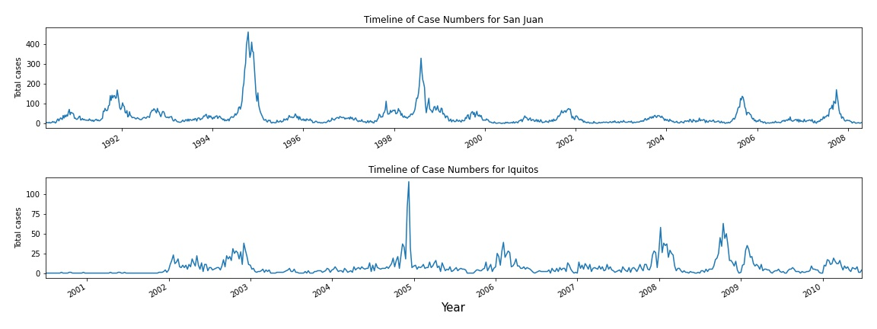
Locations Studied
San Juan, Puerto Rico
Greater case numbers, higher peak case numbers
Stronger seasonality
Stronger correlation among climate conditions
Iquitos, Peru
Fewer case numbers, fewer years of data
Case numbers don’t follow a clear seasonal trend
Wetter, more precipitation

Slide 6
How can we model this data?
There are many different families of models to use, two are used in this project:
ARIMA
Gradient Boosting

Slide 7
ARIMA
The dataset is a time series.
The features and case numbers display seasonality.
Using a SARIMAX model.
Notes:
SARIMAX(seasonal-autoregressive integrated moving average)

Slide 8
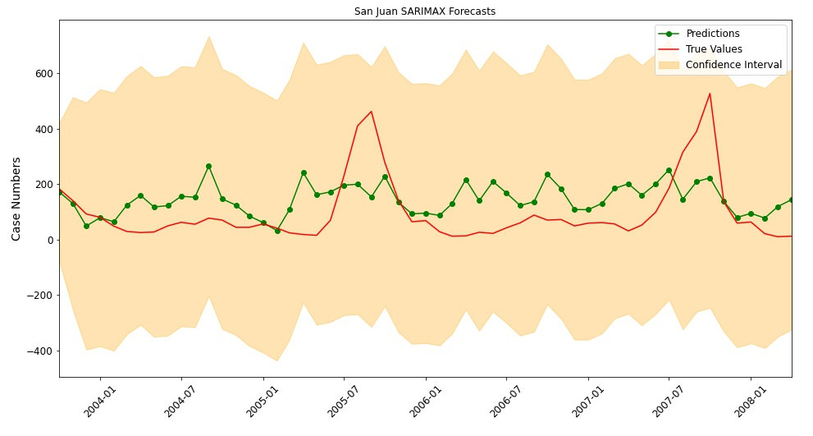
ARIMA (SARIMAX)
San Juan
Predictions are all over, mostly overestimating case numbers.
Predictions don’t fit the outbreaks at all.
The model confidence is wider than the peak outbreak case numbers.
RMSE: 119.31 (On monthly case numbers)
Notes:
RMSE: Root (MSE: avg(sum(actual values - predicted values)^2))

Slide 9
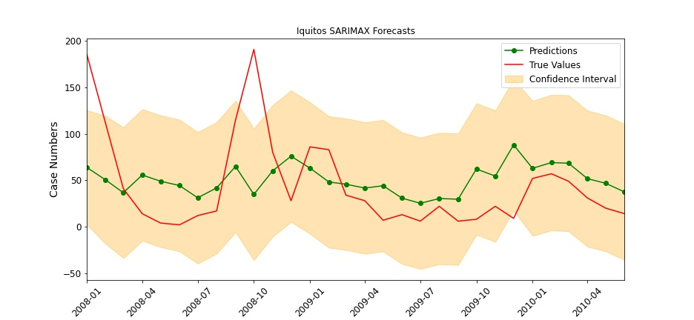
ARIMA (SARIMAX)
Iquitos
Predictions overestimate the case numbers in a similar trend to the actual case numbers.
The outbreaks are still underpredicted.
Narrower confidence band.
RMSE: 49.02 (On monthly case numbers)

Slide 10
Gradient Boosting
Tree-based model
XGBoost
Notes:
Tree-based model -Fit many weak learners, feature subset to account for the stronger correlated features.
XGBoost - Library provides an extensible approach to the Gradient Boosting model.

Slide 11
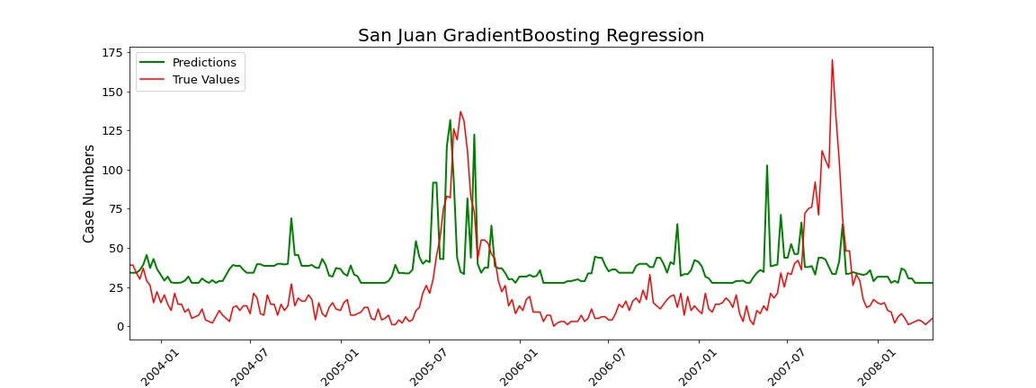
Gradient Boosting
San Juan
The model is bias towards the mean, with some spikes in case numbers during the first outbreak.
The second outbreak isn’t well predicted, no big spikes.
RMSE: 30.48 (On weekly case numbers)

Slide 12
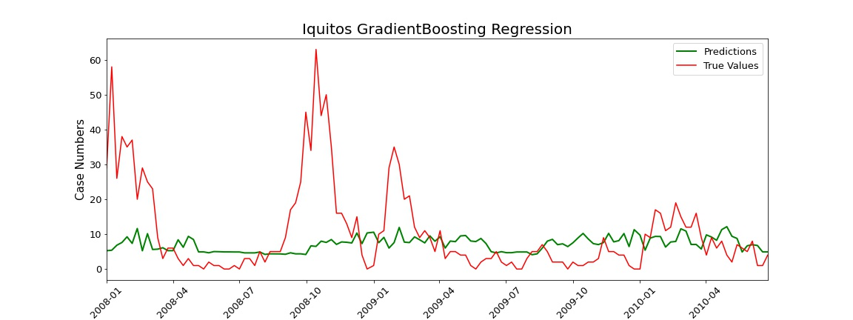
Gradient Boosting
Iquitos
Mean bias, smaller variance.
Predictions are slightly overestimated overall, with outbreak periods being strongly underpredicted.
RMSE: 13.02 (On weekly case numbers)

Slide 13
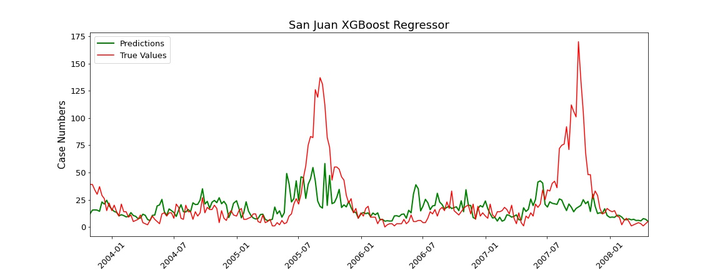
Gradient Boosting - XGBoost
San Juan
Better predictions for lower case numbers.
The first outbreak shows some deviation.
Second outbreak is still unpredicted.
RMSE: 26.78
Notes:
The model is able to predict the lower case numbers better, and indicates some deviation from the average cases during the first outbreak.

Slide 14
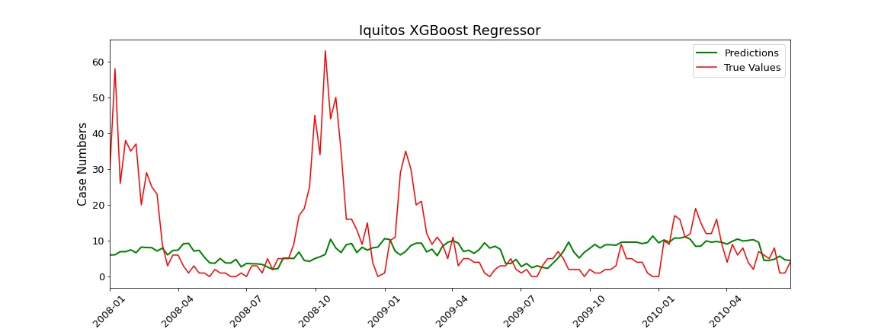
Gradient Boosting - XGBoost
Iquitos
Predictions have increased variance, but still stay near the mean case numbers.
Less over-predictions for low case number weeks.
Outbreaks aren’t predicted any better.
RMSE: 13.05

